Slide 1
Capstone Project
Battle of Neighbourhoods

Slide 2
Background
Relocation has become more and more common with the age of internet. Opportunities are now more accessible for people across the country and even the world. This project will review different neighbourhoods, and how we can use data to identify similar locations based on restaurants that were in your hometown.

Slide 3
Problem
Relocation is a common theme amongst young millennials today trying to pursue their careers nowadays. They will want to find similar types of neighbourhoods and restaurants that they are accustomed to in t heir hometowns. We will explore how clustering can be used to pinpoint the areas that they would like to live at.

Slide 4
Data
This project will use Foursquare location data to identify comparable neighbourhoods based on restaurants and event data. Information will be gathered from https://en.wikipedia.org/wiki/List_of_postal_codes_of_Canada:_M which will be clustered for this project.
Clustering will help solve what neighbourhoods that young millennials will like to relocate to based on their previous neighbourhoods.

Slide 5
Methodology
Collect Data
Explore and Understand Data
Clean and prepare Data
K-Means clustering to perform city segmentation
Create models based on analysis

Slide 6
Results
Collected location data from Foursquare API interface.
Extracted Postal Codes, Boroughs, Neighbourhoods in Toronto..
Clustered neighbourhoods in order to find existing business establishments and venues in order to find similar neighbourhoods to their hometowns.

Slide 7
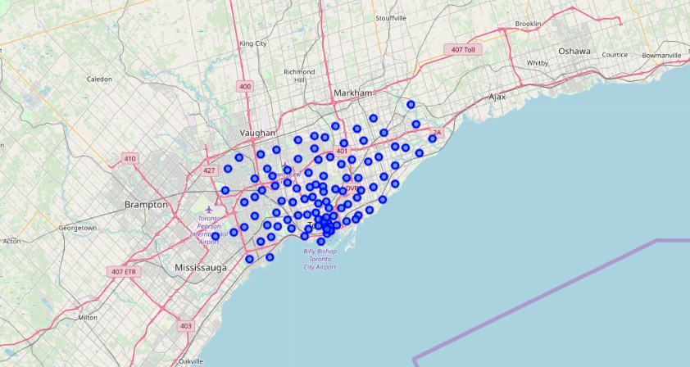

Slide 8
Clusters
Cluster 1 – 13 Neighbourhoods with most common venue being 9 coffee shops
Cluster 2 – 1 Neighbourhood with 1 similar coffee shop
Cluster 3 – 1 Neighbourhood with 1 similar coffee shop
Cluster 4 – 2 Neighbourhoods with 1 similar grocery store and 1 café
Cluster 5 – 1 Neighbourhood with 1 similar coffee shop

Slide 9
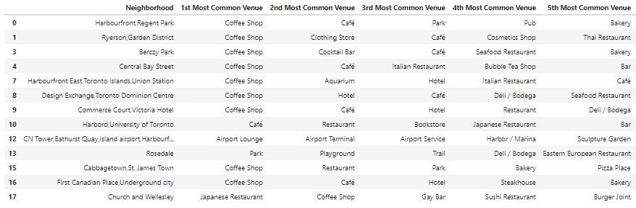
Cluster 1
Cluster 2
Cluster 3
Cluster 4
Cluster 5

Slide 10
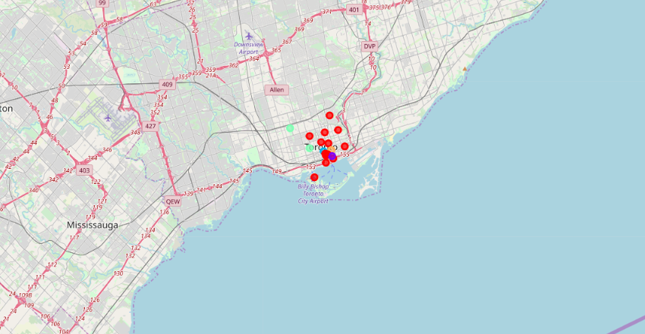

Slide 11
Discussion
These clusters give as an overview of all the neighbourhoods that will have similar coffee shops in the area. Cluster 1 has the most similarities along with diversity.

Slide 12
Conclusion
The k-means clustering technique gives a good idea on what neighbourhoods these young millenials would like to move to based on the venues identified using Foursquare API.
Cluster 1 neighbourhoods would be a great fit for relocation to make the transition easier when moving to a new city.

